Slide 1
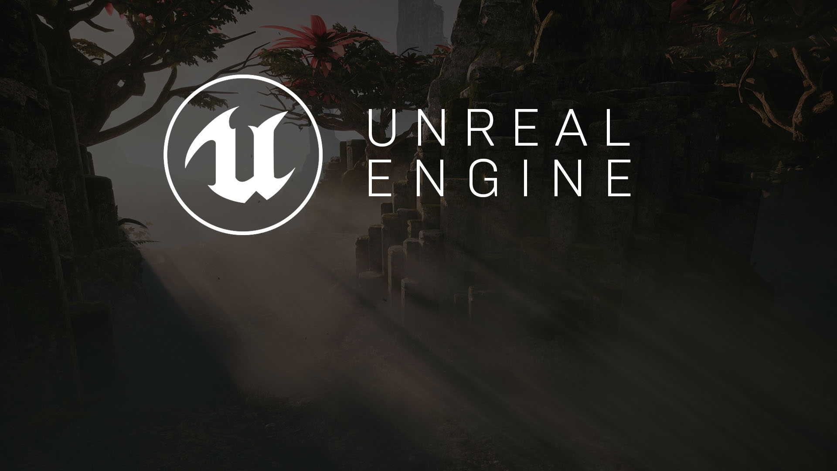
Game Design
A Breakdown of the Elements

Slide 2
Game Development Basics
Describing a Game Design Concept

Slide 3

Develop
Test
Evaluate
Design
Game Development Life Cycle
While it’s easy to think of game development as being a linear process where you have an idea for a game, you develop it, and you release it, the real process requires substantially more iteration. Each mechanic needs to be designed, developed, tested, evaluated, and then redeveloped based on feedback until it is effective within a given project.

Slide 4

How would you describe a game of tag?
If you were to describe a game of tag, you might do it like this:
In a game of tag, a collection of players run around a space, typically a schoolyard, avoiding a player that is considered “it.” Whenever a player that is “it” touches, or tags, another player, the tagged player becomes “it” while the original player is now no longer “it.” Players need to avoid being “it” for as long as possible. The game is over after a set amount of time.
While this description may be sufficient for describing the game to a friend, it fails to describe it in a game design context.

Slide 5
Space
It’s possible to break up the core elements into categories.
Goals
Actors
Mechanics
Rules

Slide 6
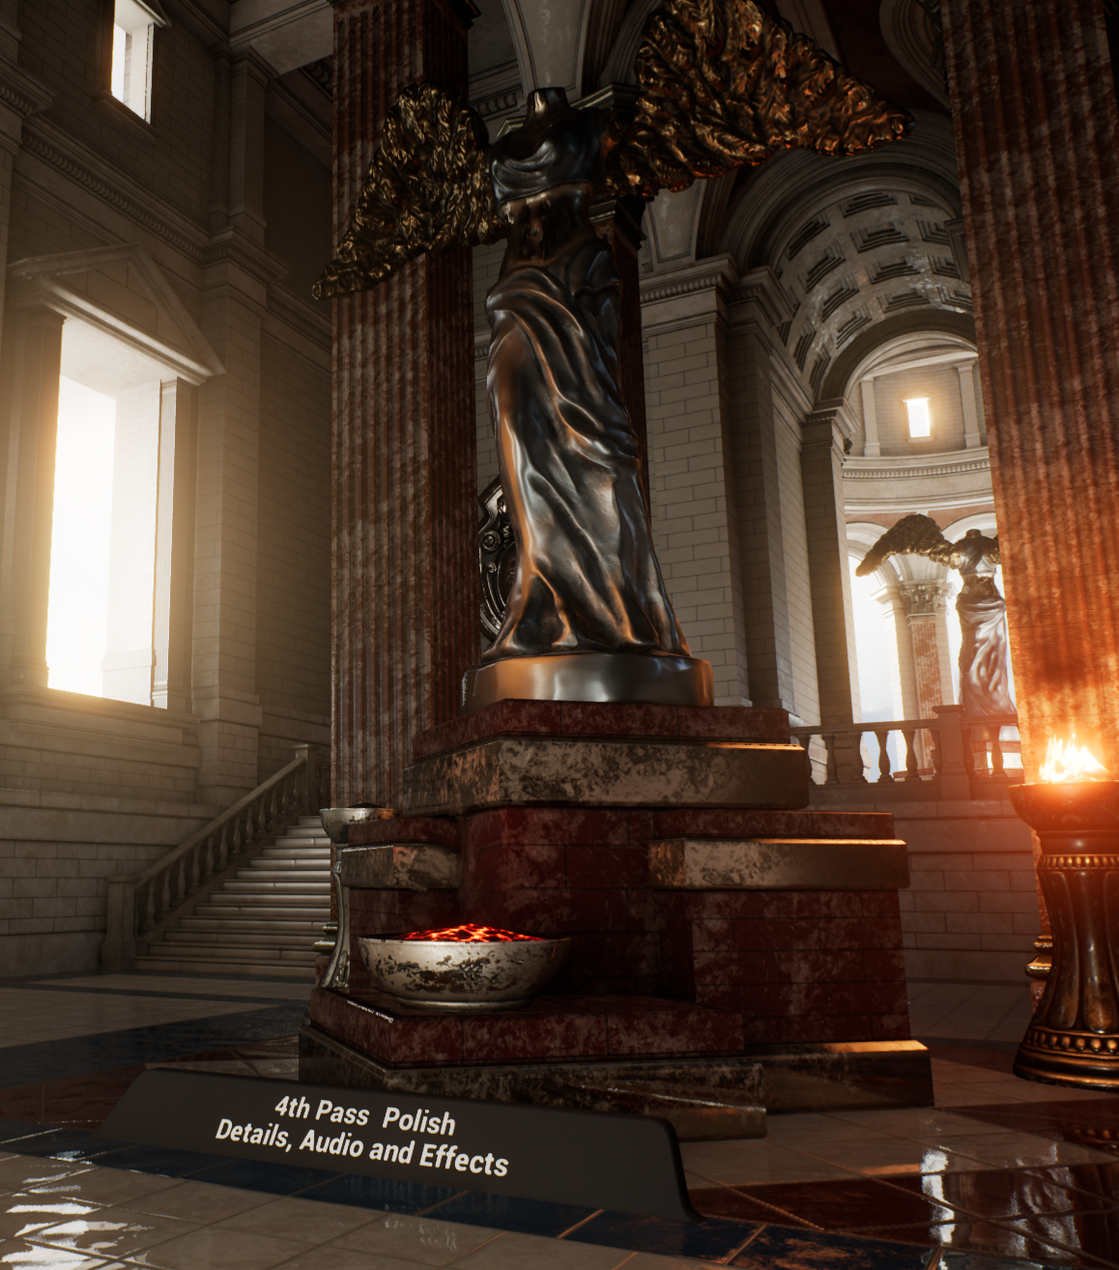
Space
The space is the environment in which the gameplay will take place. This description applies to both aesthetics and the design of the space.
Will the space be 2D or 3D?
Will the z axis matter to players?
How will cover and other environmental factors alter other design elements?
Will the gameplay take place in large open spaces or in tight corridors?

Slide 7
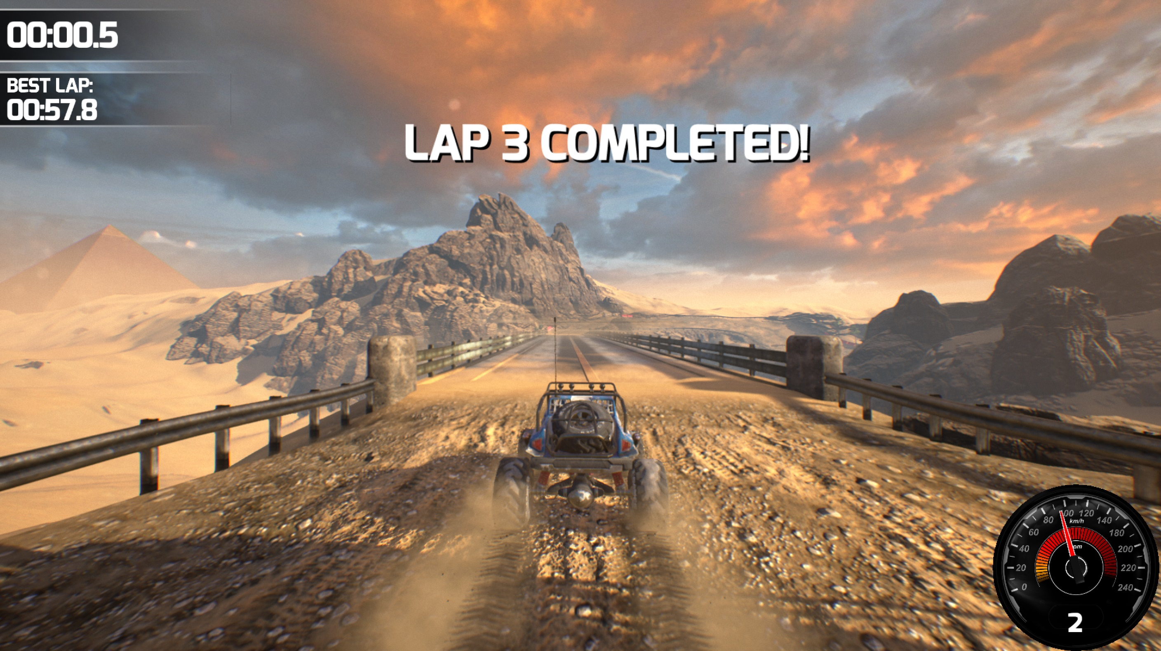
Goals
The goals are what players must do to win or complete a game and represent the overall objectives to players. Should the player be completing a circuit? Knocking enemy players from the arena?

Slide 8
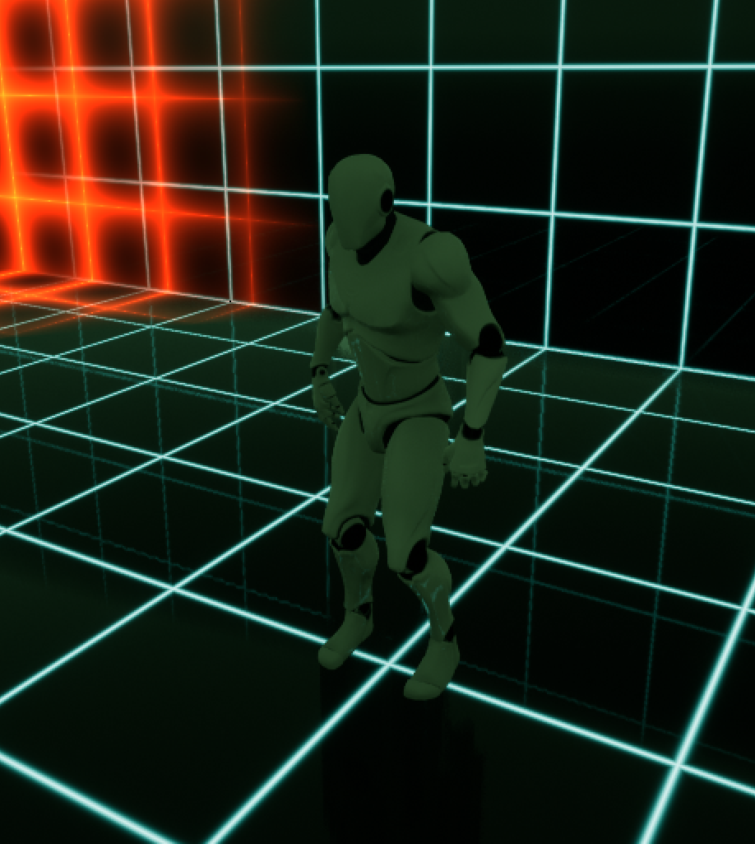
Actors
Actors are the main components within a game. They are the objects that are interacted with and controlled within the environment.
Players, weapons, and pickups are common types of actors.

Slide 9
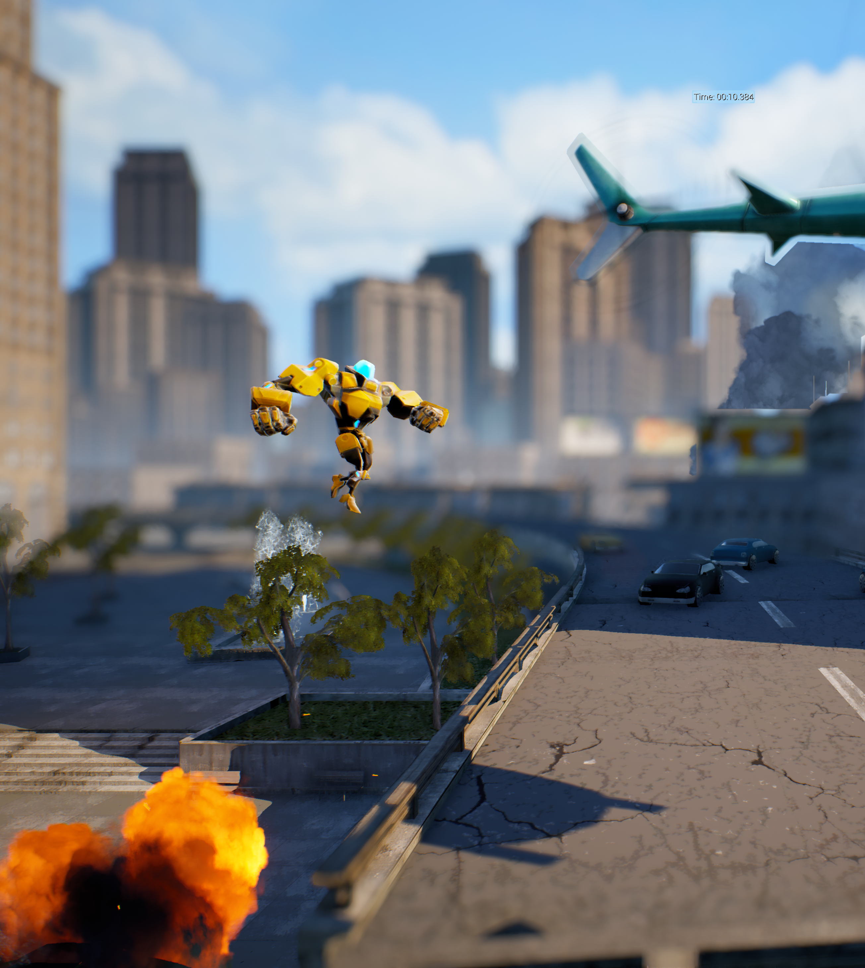
Mechanics
Mechanics detail the actions that a player or other actors can do during the game. Sometimes mechanics are designed for compatibility between one another. For instance, while a player may be able to jump and slide, a new mechanic may be borne from sliding when landing.
Jumping, sliding, diving, and firing projectiles are all considered as different mechanics.

Slide 10
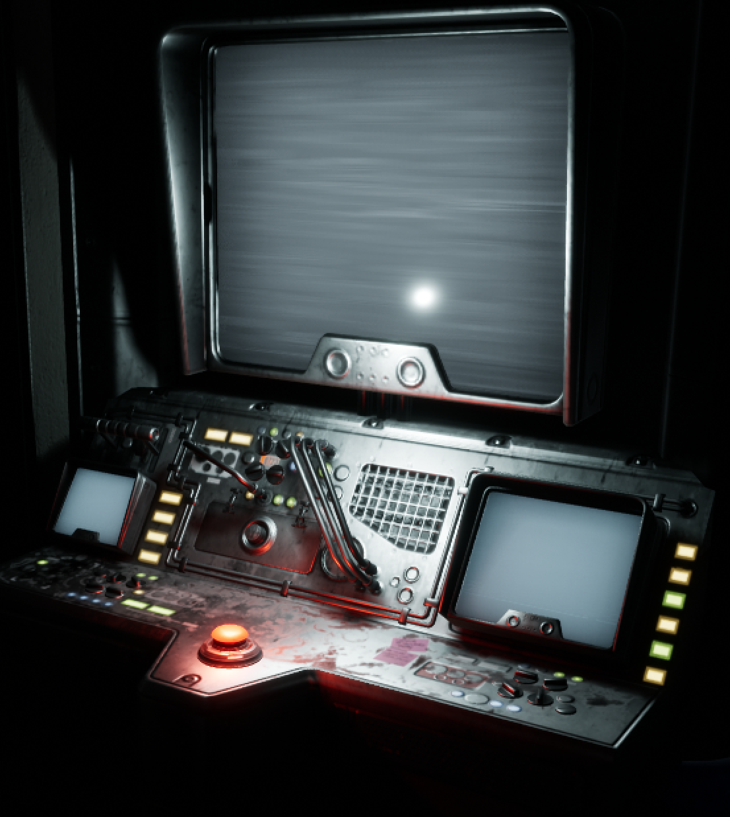
Rules
The rules describe how to play the game and the constraints in the game world. What must the players do to achieve their goals? What should they be wary of? What happens when a rule is broken? What happens if a rule is consistently adhered to?

Slide 11
Actors
The actors in the world are the players in the game of tag.
Mechanics
Therefore, in a game of tag . . .
The mechanics are that once tagged you become “it” and you change teams.
Goals
The goal is to avoid being tagged or to tag other players.
Space
The space is determined by the schoolyard play area.
Rules
The rules are that you cannot leave the space, tag back within x seconds, or climb trees.

Slide 12
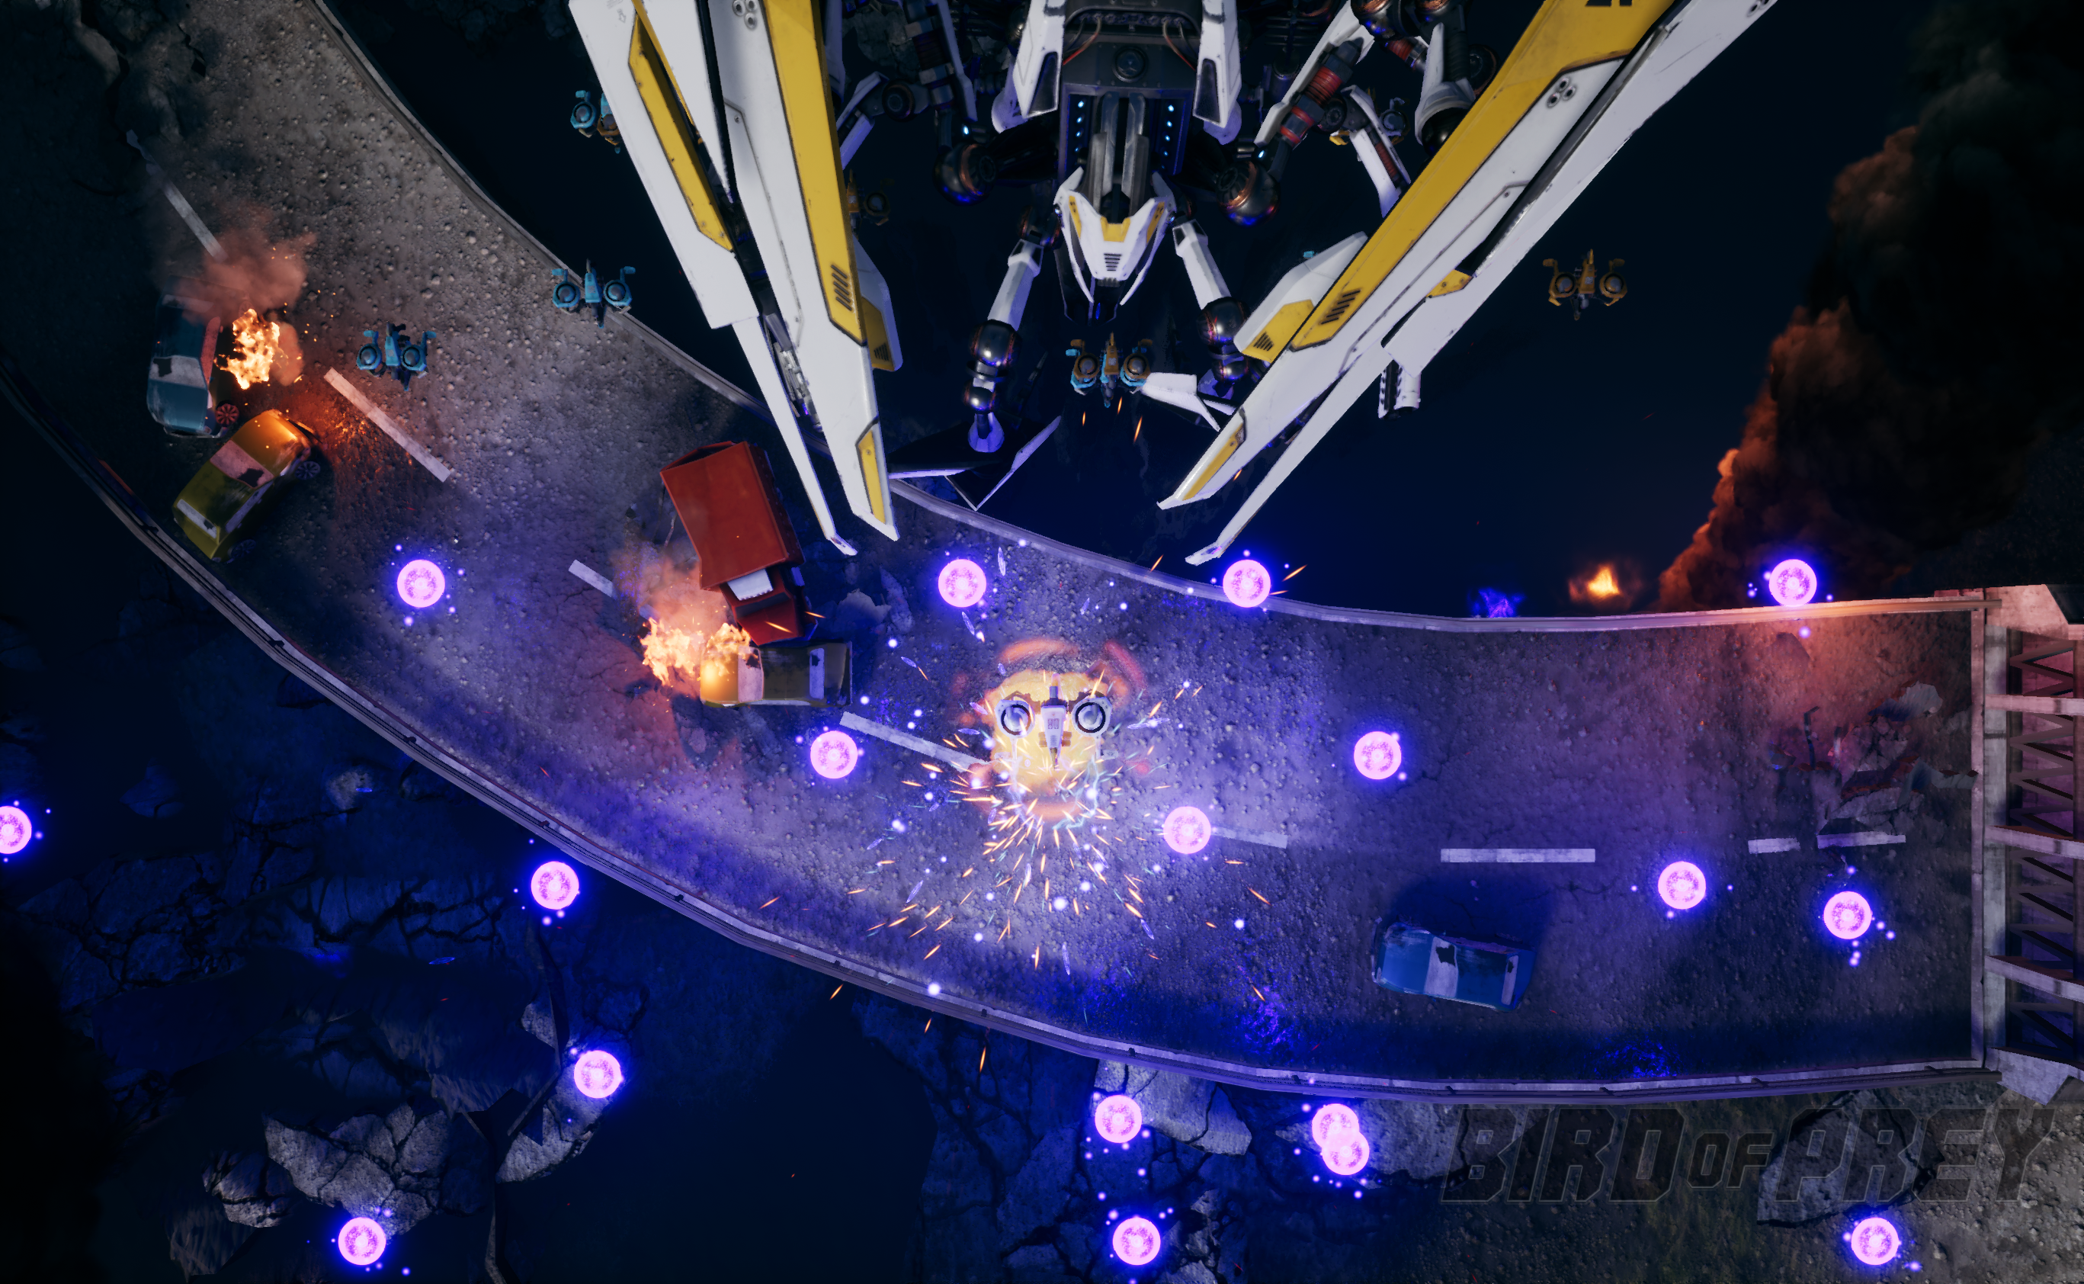
Bird of Prey
This project has been assembled as a basis for understanding various game design elements within a sample project.
Can you identify the different elements of game design featured in the project?

Slide 13
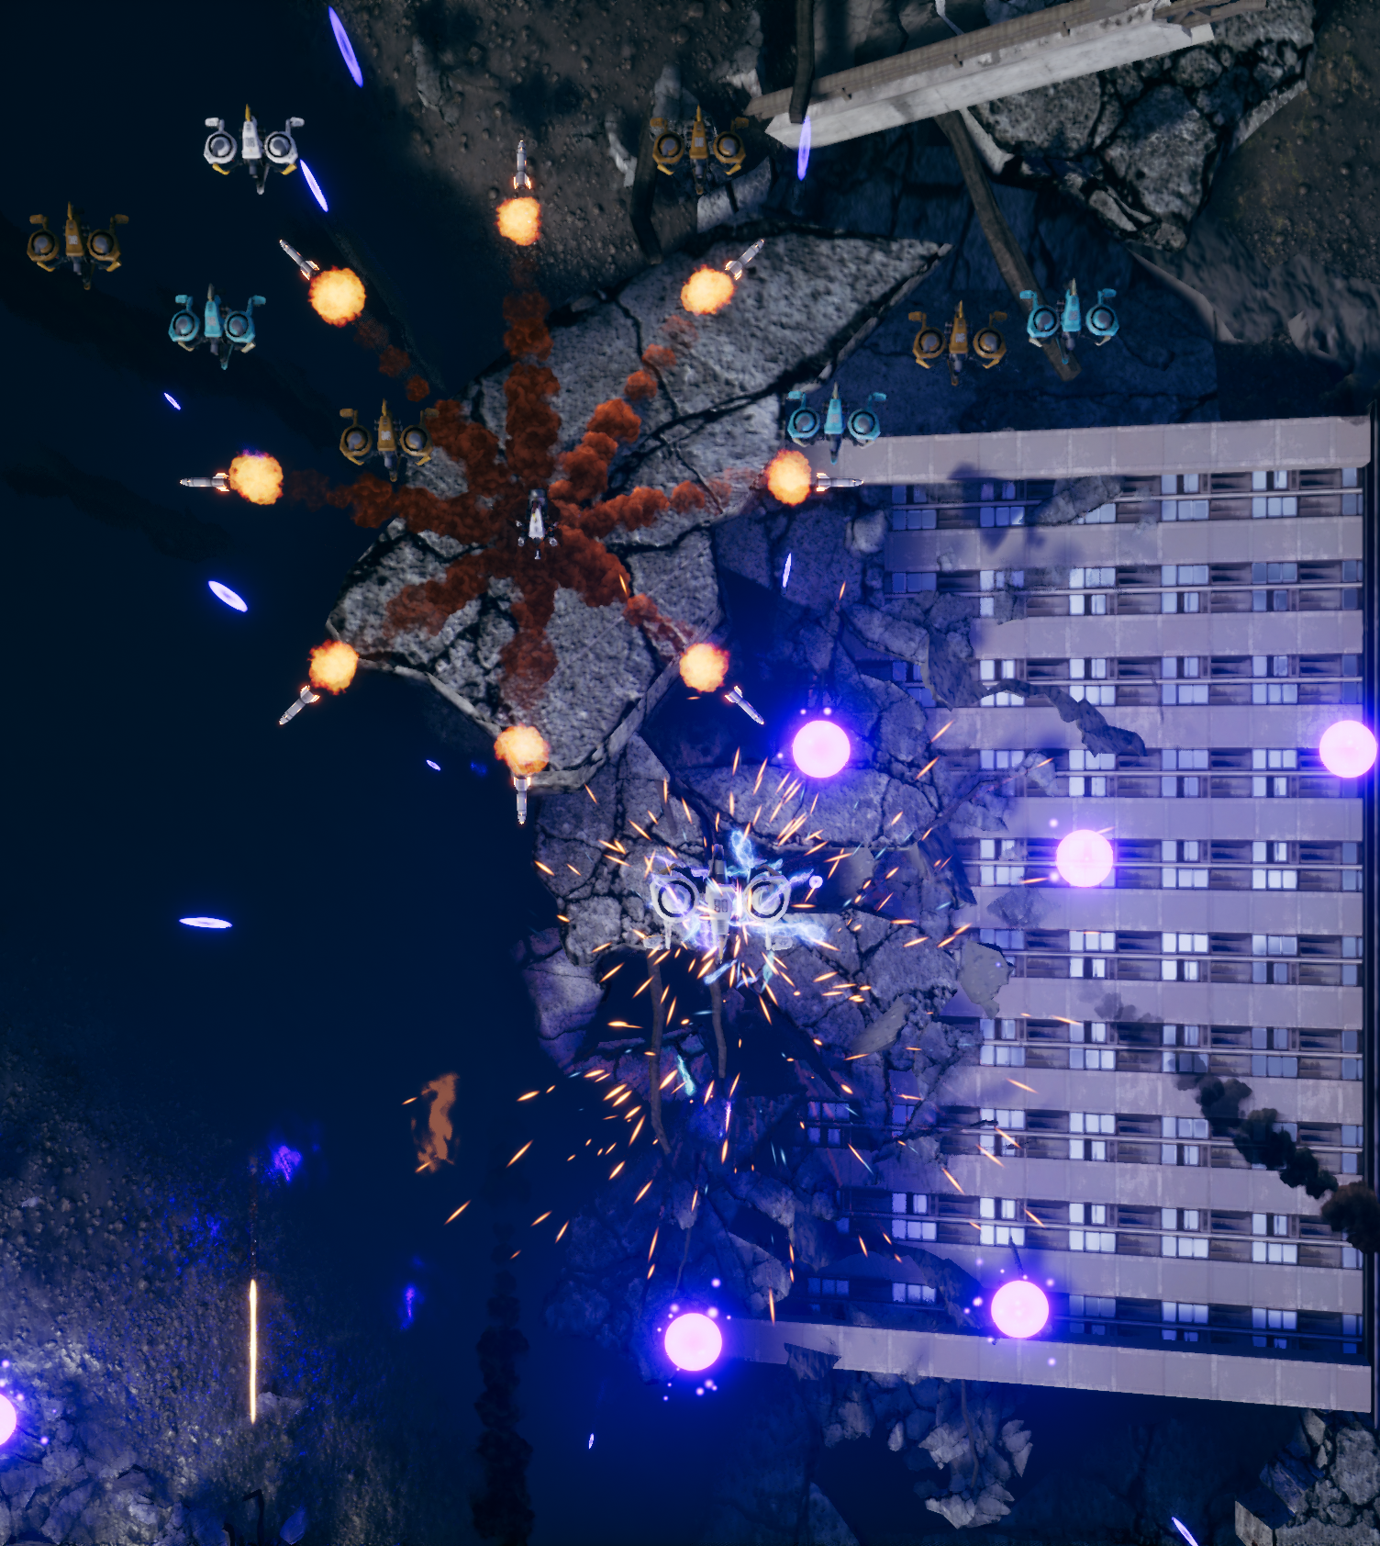
Bird of Prey:
Actors
The ships, pickups, and projectiles throughout the arena are the main actors in Bird of Prey. Different weapon pickups award the player with different types of weapon patterns/projectile types.

Slide 14
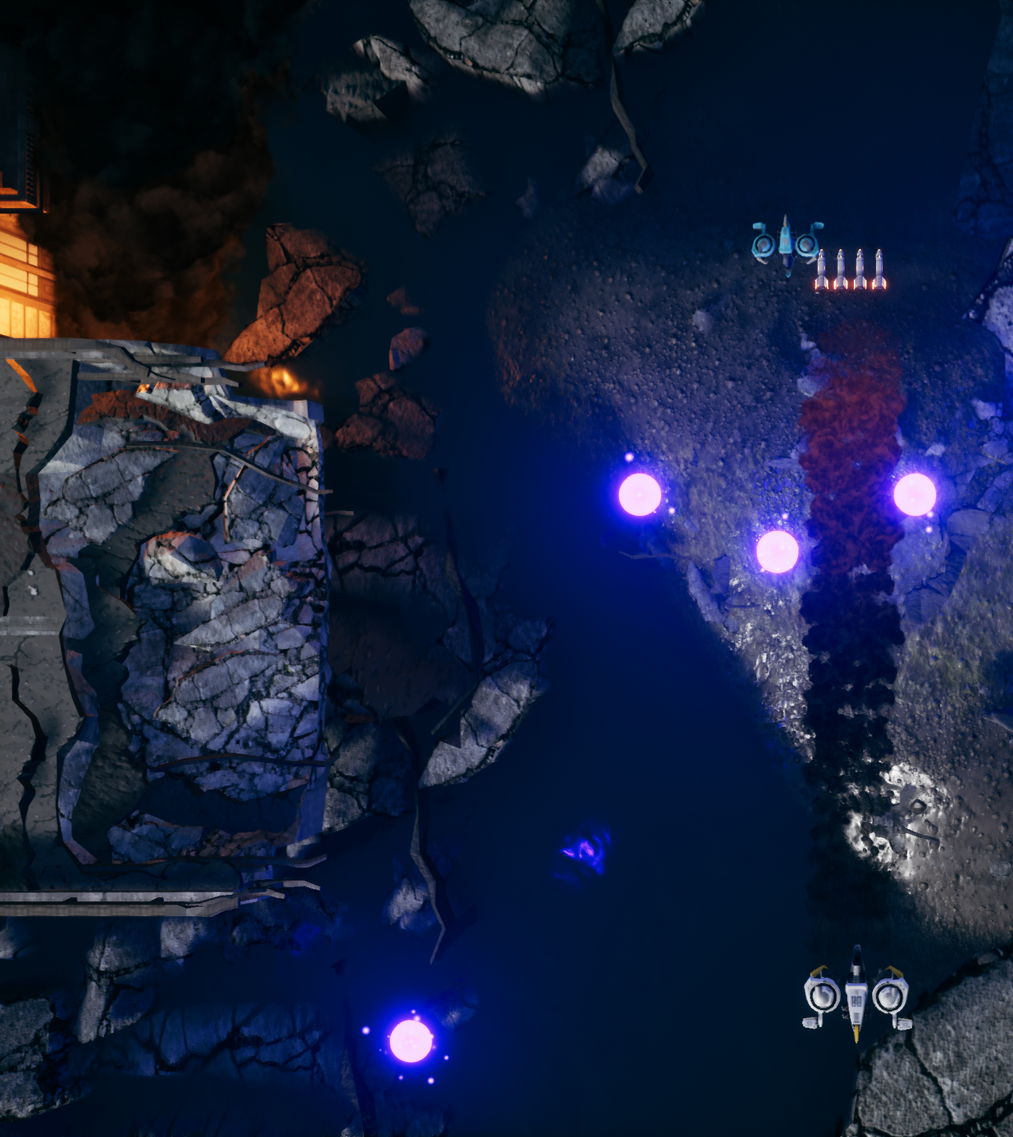
Bird of Prey:
Mechanics
The player ship is able to maneuver, fire weapons, and collect pickups. When enemies or the player is shot, they will receive damage. Ships will explode when they’ve taken too much damage.

Slide 15
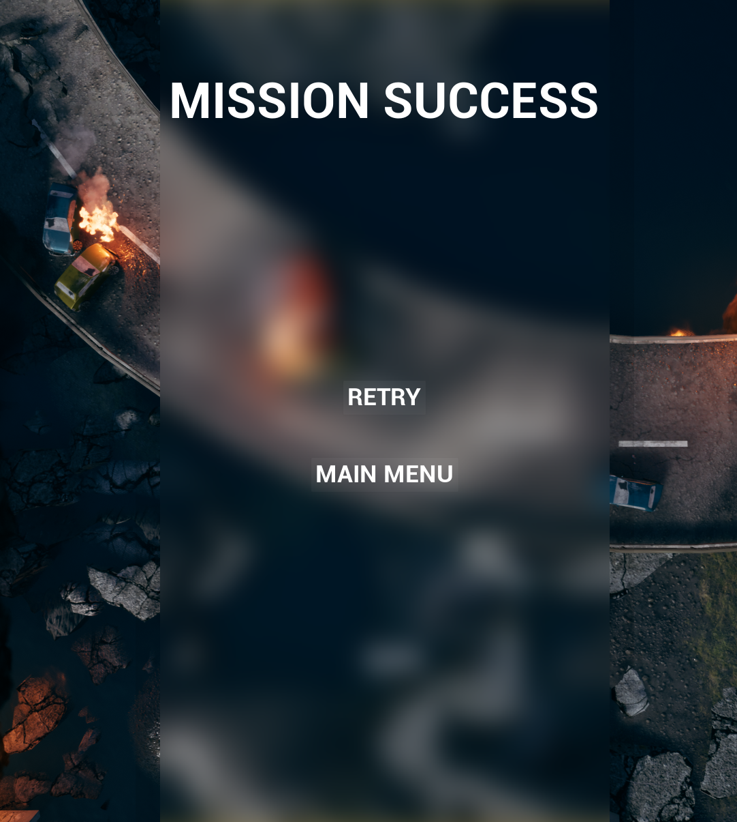
Bird of Prey:
Goals
To complete the level, the player ship must reach the end of the map and defeat the boss. When the boss has been defeated, the player has won.

Slide 16
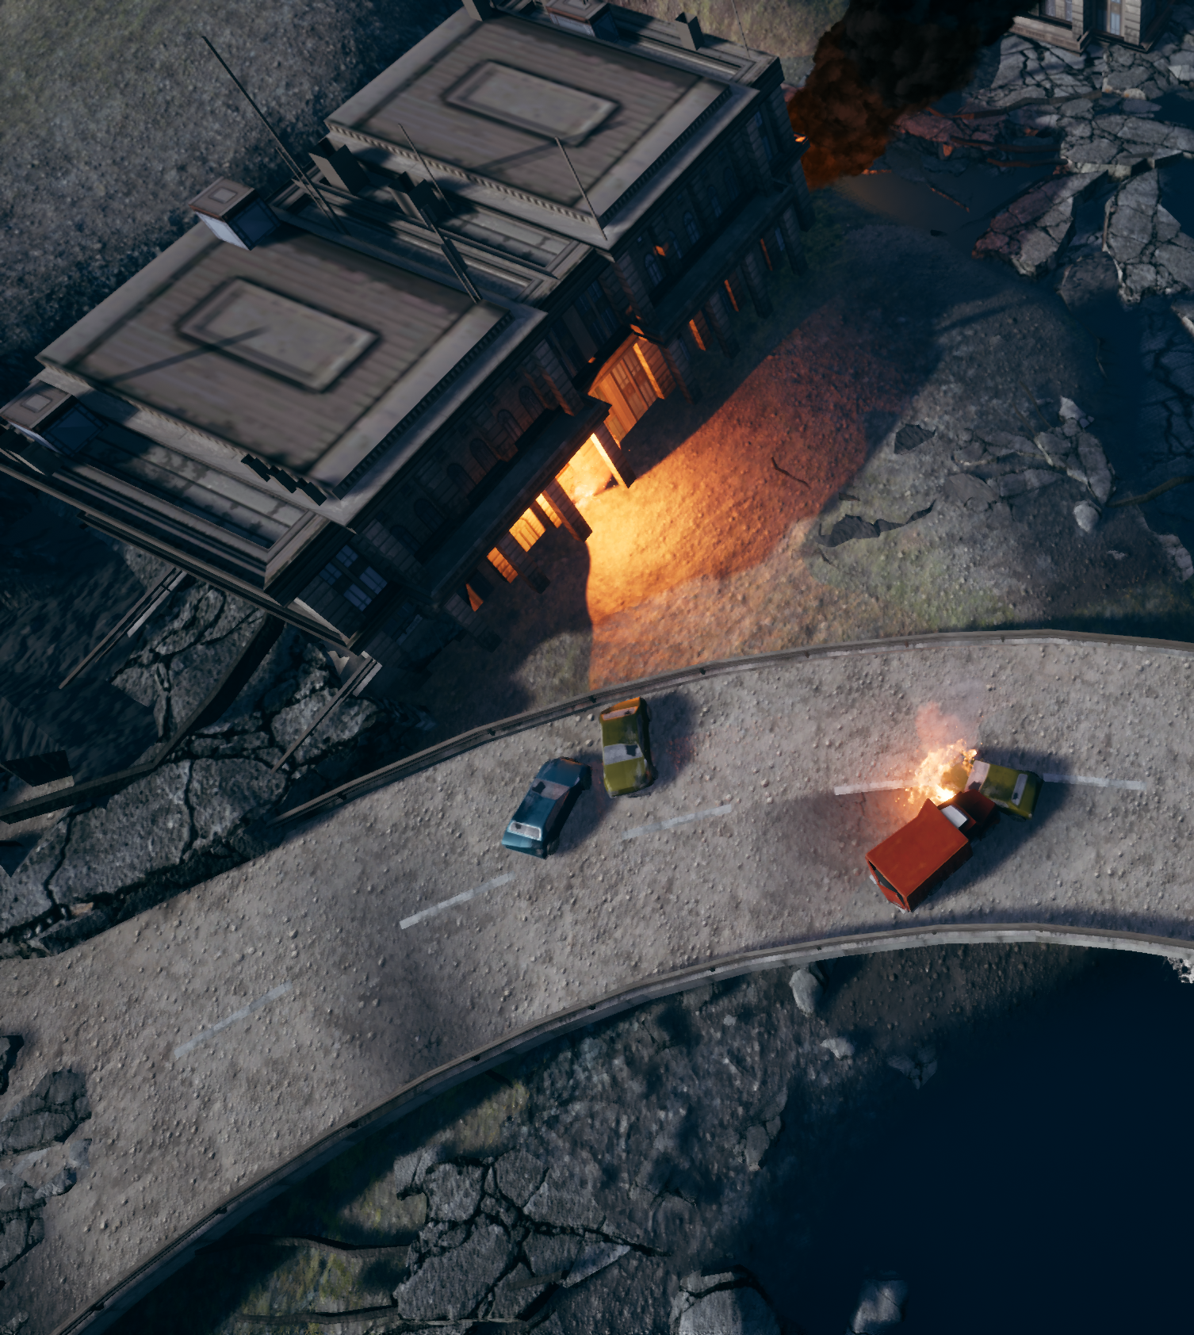
Bird of Prey:
Space
The space exists on a consistent xy plane. There are no obstacles; however, the player has limited mobility when moving away from the central camera position. Aesthetically, Bird of Prey takes place in a ruined city with smoke and debris limiting enemy visibility.

Slide 17
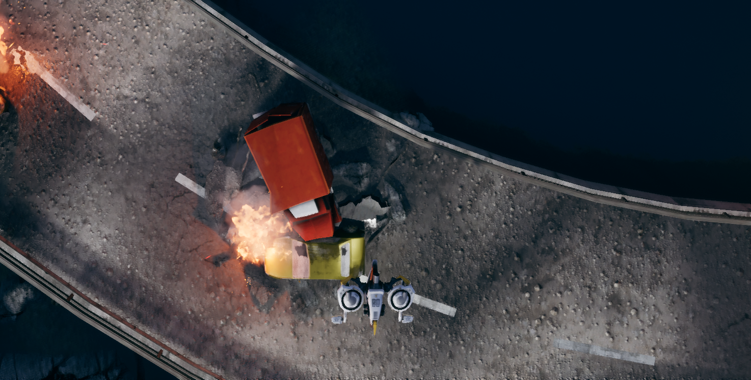
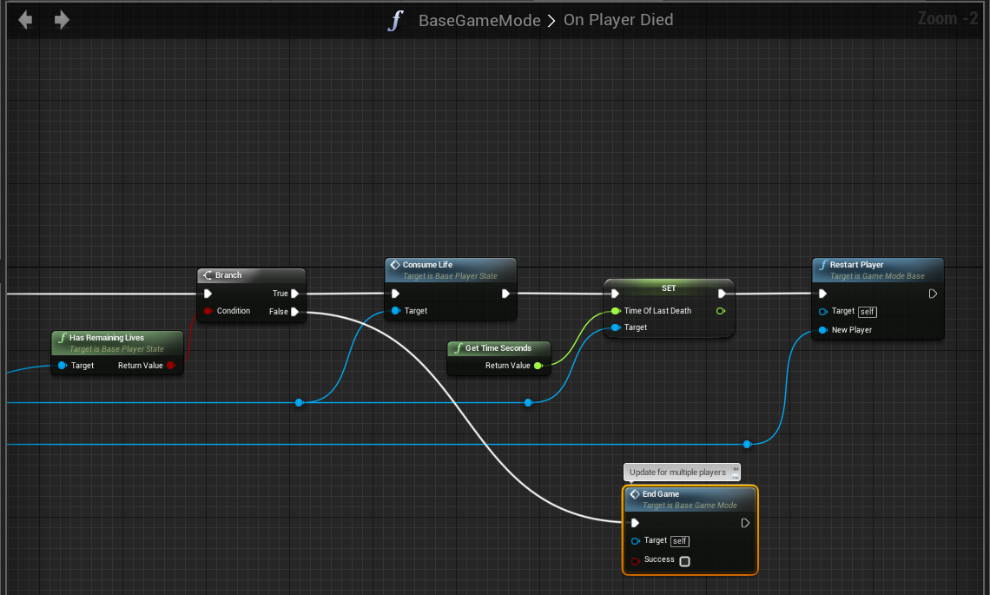
Bird of Prey:
Rules
If the player is destroyed, they will respawn while they still have lives remaining. Enemies do not respawn. Enemies that pass through the screen will be automatically destroyed; however, no points will be awarded to the player.

Slide 18
Player Motivations
How to Make Players Do Something and
. . . Keep Doing It

Slide 19
What drives a player to keep playing?
Positive Reinforcement
Rewarding the player for performing behaviors that the designers would like to encourage
Negative Reinforcement
Taking away a negative stimulus when the player performs a desired action
Punishment
Applying a negative stimulus for performing an undesirable action
Studies have shown that while punishment is the most effective method of ensuring a player avoids performing a behavior, positive reinforcement at random intervals is the most effective for ensuring that a player continues to perform desirable actions, even in the absence of positive reinforcement.

Slide 20
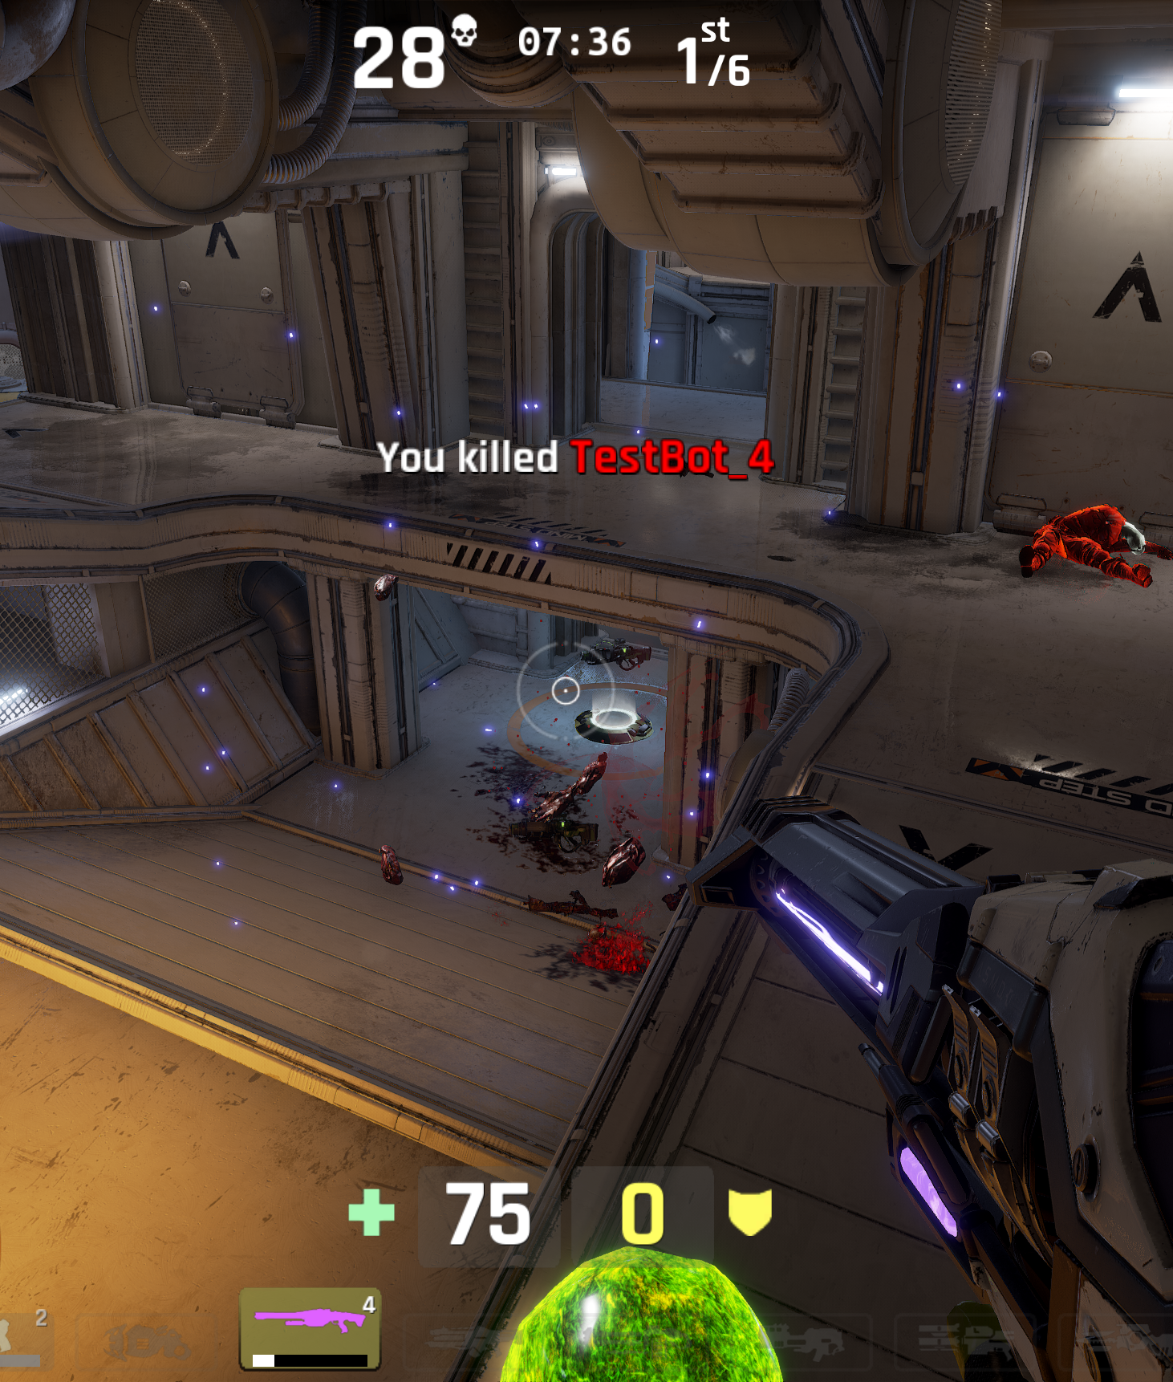
Positive Reinforcement
Armor
New weapons
New items
Negative Reinforcement
Defeat of enemies
Removal of tutorial prompts
Punishment
Player death
Loss of weapons
Loss of items

Slide 21
Documentation
Let’s Just Get This out of the Way . . .

Slide 22
Documentation
Types
During the development of a project, it’s important that all stakeholders have a mutual understanding of the project.
Whether a team member is an artist, programmer, designer, marketer, or other type of professional, they need to know the goals and intent behind the decisions made by the team.
For this reason, the following pieces of documentation are typically developed by teams when going into full production of a project:
Design document
Pitch document
Feature matrix
Art bible
Art budget
Production budget

Slide 23

Pitch Document
A pitch document is used to recruit team members, apply for publication or grants, and generally gather support for a project your team will develop.
This document is usually tailored to its intended audience; however, it typically focuses on the following:
What are your project aims?
What is unique about your project?
Why is the project exciting or marketable?
What skills/plans do you have to overcome any hurdles?
The pitch document typically needs the support of prototypes and concept art to fully illustrate the intent.

Slide 24
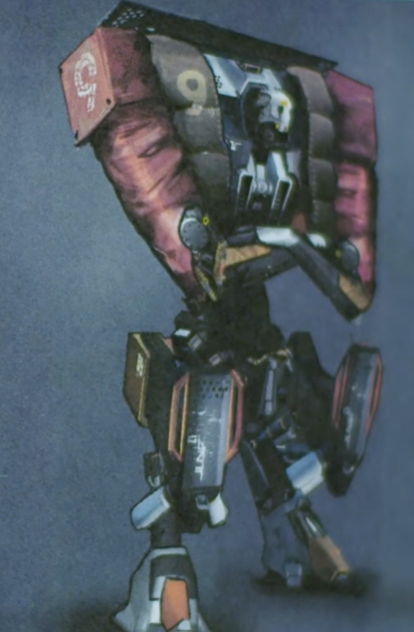
“ODIN”
An arcade-style VR shooter
Design by
Epic Games
Design Document
A design document outlines all core mechanics, references, and conceptual development plans for a project.
It is a somewhat organic document that changes as production continues, but it is essentially a document that at all times can be referenced and examined by the team to better understand both mechanic implementation and the reasoning behind various mechanics.

Slide 25

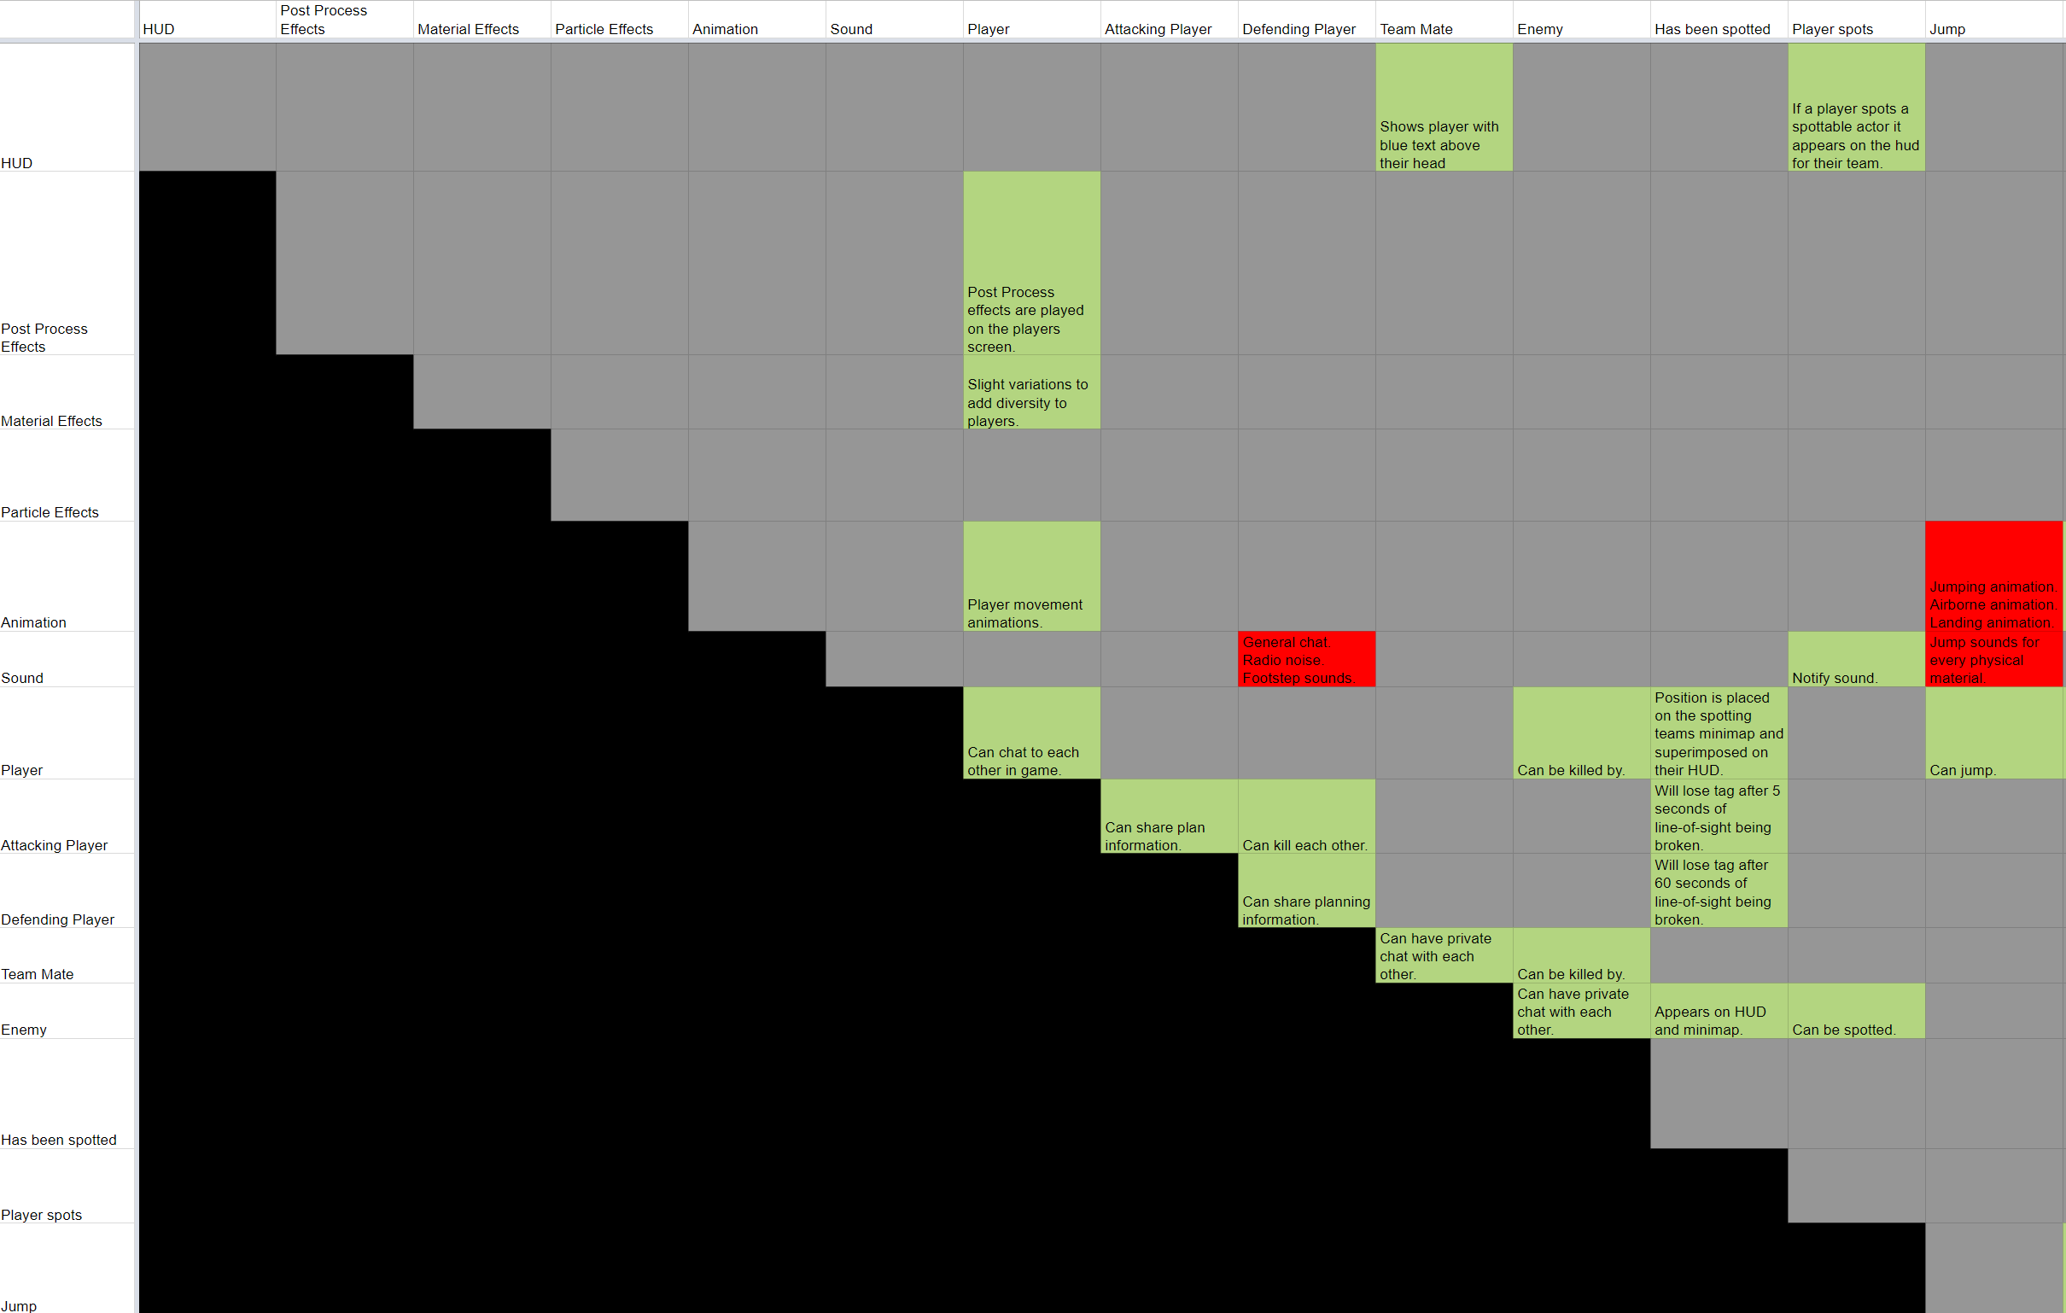
Feature Matrix
A feature matrix is a chart plotting every feature in the game against every other feature and what their interactions mean.
While creating a Feature Matrix may seem like an arduous task, its development often reveals many potential interactions that hadn’t previously been considered.
Example Feature Matrix

Slide 26
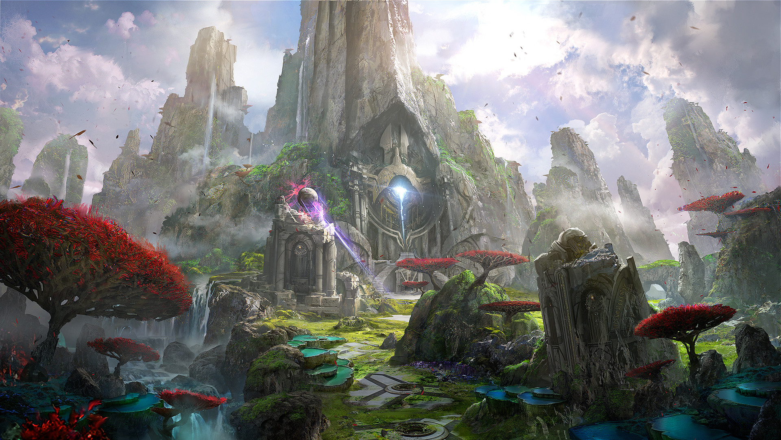
Art Bible
An art bible is a collection of reference materials, concept art, and proof of concepts. This document is used as a way of communicating the visual themes and concepts of a project to the art, audio, and visual effects teams.

Slide 27
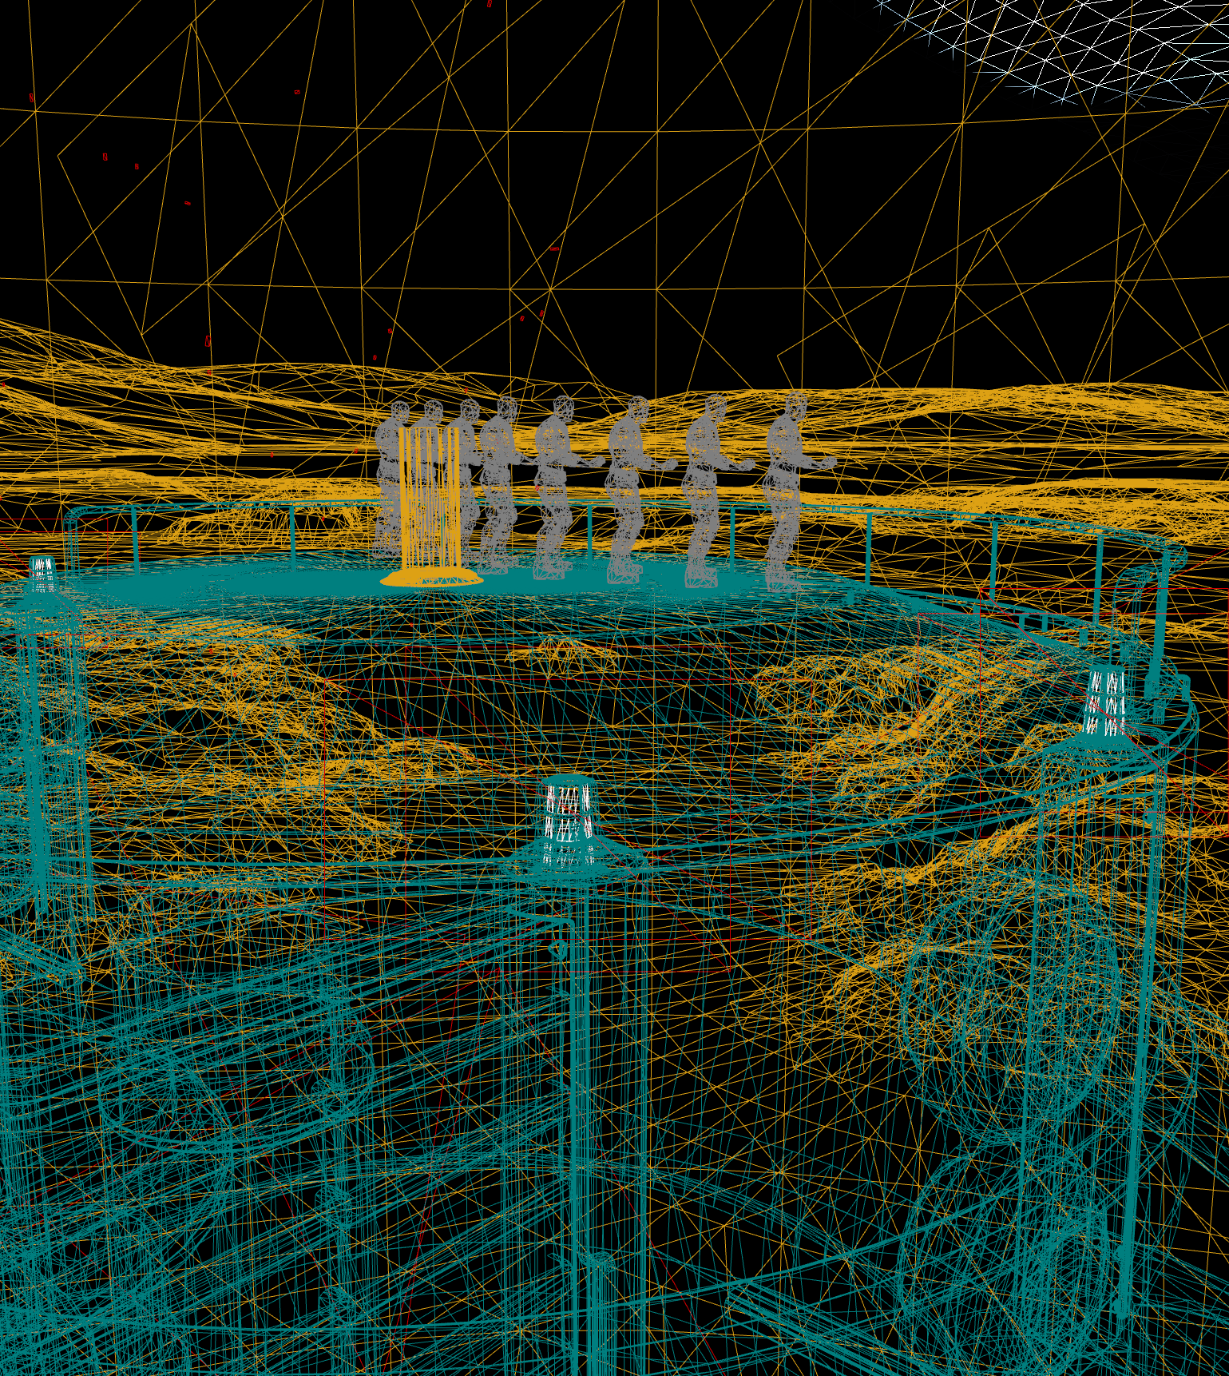
Art Budget
Unlike an art bible, which focuses on final design and output, the art budget is a document exploring maximum threshold for various art pieces, such as vertex counts on meshes, number of UV sets, number of materials, number of LOD models, or instruction counts. This document is a technical reference for artists and tech artists to adhere to.

Slide 28

Production Budget
The development of a game, even an indie or student project, will always have costs associated with it. Staff wages, rent, exhibiting costs, server costs, website costs, and equipment costs will almost always factor into development at some point, and these costs need to be determined ahead of time so that the team is never put into a position of financial insecurity. Remember to include slack time and contingency funding, as game development rarely goes according to plan!

Slide 29
Conclusion
Questions?

